Slide 1

Meta Learning
Supervised Learning

Slide 2
报告
报告人：柳玉豹

Slide 3
CONTENT
1
Introduction
2
Part: Supervised Learning
3
Latest topics
4
Conclusion: for us

Slide 4
1

Slide 5
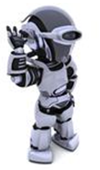
Task 1: speech recognition
Task 2: image recognition
Introduction
…
Task 101: text classification
Meta learning = Learn to learn
Learning
task 1
I can learn task 101 better because I learn some learning skills
Learning
task 2
Be a better learner
……
Learning
task 100
Meta: How to learn a new model

Slide 6





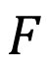
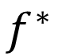
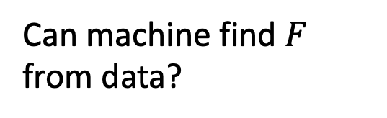
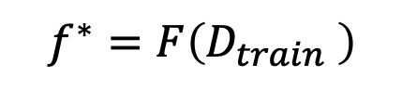
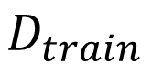
$$f^{∗}=F\left(D_{train} \right)$$
Meta Learning
Can machine find $F$ from data?
Designed by Developers
cat
It is also a function.
Learning
Algorithm
$$f^{∗}$$
$$F$$
cat
dog
cat
dog
Training Data
Testing Data
$$D_{train}$$

Slide 7

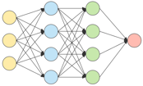
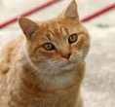
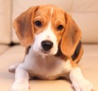


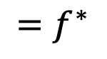
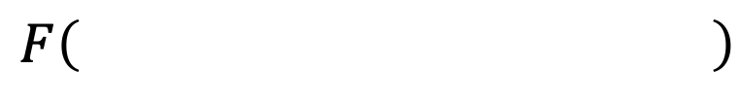
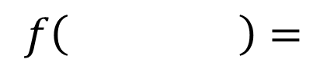
Meta Learning
Machine Learning
≈ 根据资料找一个函数 f 的能力
$$f\left( \right)=$$
“Cat”
Meta Learning
≈根据资料找一个找一個函数 f 的函数 F 的能力
$$F\left( \right)$$
$${=f}^{∗}$$
cat
dog
cat
dog
Training Data

Slide 9
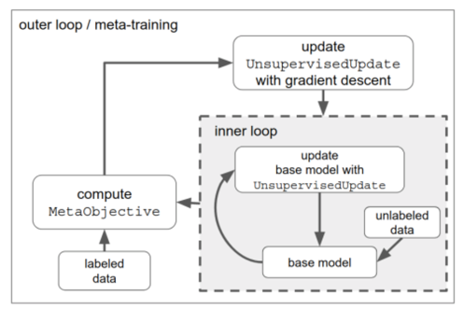
Meta Learning
Supervised Learning
Unsupervised Learning
Reinforcement Learning
如何用无监督数据更新网络参数呢？
让模型学习一个和当前训练状态相关的动作策略
ICLR19：https://openreview.net/pdf?id=HkNDsiC9KQ
https://arxiv.org/pdf/1810.02334.pdf
Notes:
Unsupervised的核心：先利用无监督数据更新一下网络参数，然后利用更新后的网络参数来做新样本的学习。
具体的如K-means分类，作为标签
原来有loss，现在自己额外构造一个神经网络利用当前参数来直接预测要更新的参数
RL： state ， transition， reward function 举例：迷宫

Slide 10
PART TWO

Slide 11
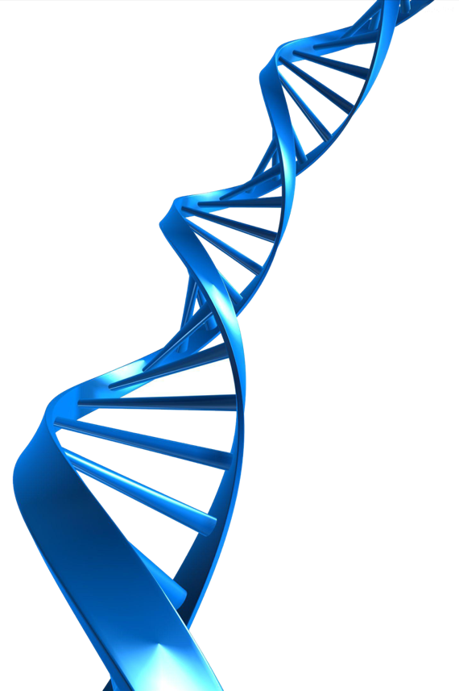

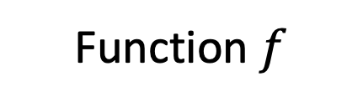
Machine Learning is Simple
Meta
01
Define a set of function
02
Goodness of the function
03
Choose the best function
Function $f$
Learning algorithm $F$

Slide 12

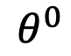
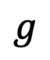
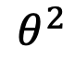
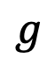
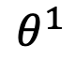
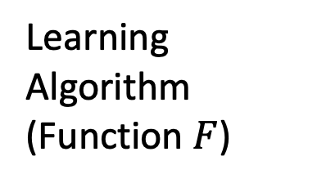
Meta Learning
Step 1: Define a set of learning algorithm
$$\hat{θ}$$
Network
Structure
Update
Update
$$θ^{0}$$
$$θ^{1}$$
$$θ^{2}$$
Init
$$g$$
$$g$$
Learning Algorithm
(Function $F$)
Compute Gradient
Compute Gradient
Training
Data
Training
Data
Notes:
不同 红色 框的选项决定了不同的算法
目前都由人手动选择（initialization、gradient计算、乘以学习率作参数更新）
交由meta learning去做

Slide 13
Used for Auto ML
常规 ML framework 如下图灰色部分：
导入数据-数据清洗-特征工程-分类器-输出预测值
auto部分如下图绿色方框：
左边新增 meta-learning，自动学习样本数据模样，自动推荐合适模型（文本数据用什么模型较好）
在右边新增 build-ensemble，调超参数（贝叶斯优化）

Slide 14

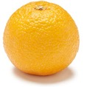
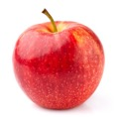

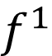
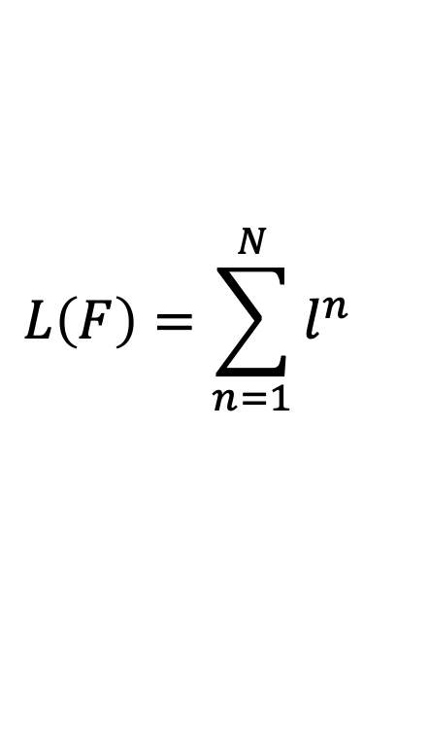
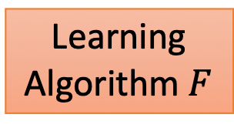
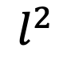
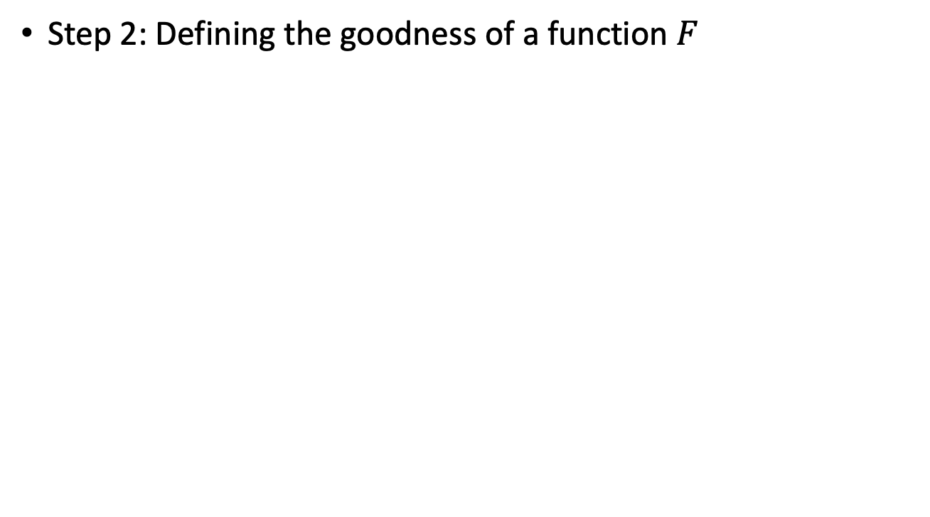
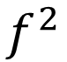

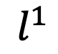
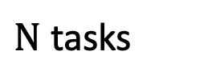
$N$ tasks
$$L\left(F\right)=\sum_{n=1}^{N}{l^{n} }$$
Meta Learning
Testing loss for task n after training
Step 2: Defining the goodness of a function $F$
Train
Train
cat
dog
apple
orange
Task 1
Task 2
Learning
Algorithm $F$
Learning
Algorithm $F$
Test
Test
$$f^{1}$$
$$f^{2}$$
cat
dog
apple
orange
$$l^{1}$$
$$l^{2}$$

Slide 15


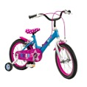
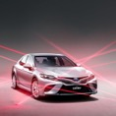
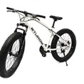

Machine Learning
Meta Learning
Widely considered in
few-shot learning
cat
dog
cat
dog
Train
Test
Support set
Query set
Task 1
Train
Test
Training
Tasks
cat
dog
cat
dog
Task 2
Train
Test
apple
orange
apple
orange
Sometimes you need validation tasks
Testing Tasks
Train
Test
bike
car
bike
car

Slide 16
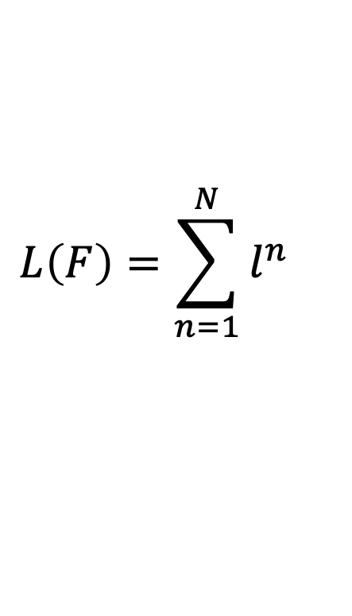
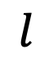
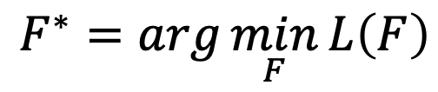
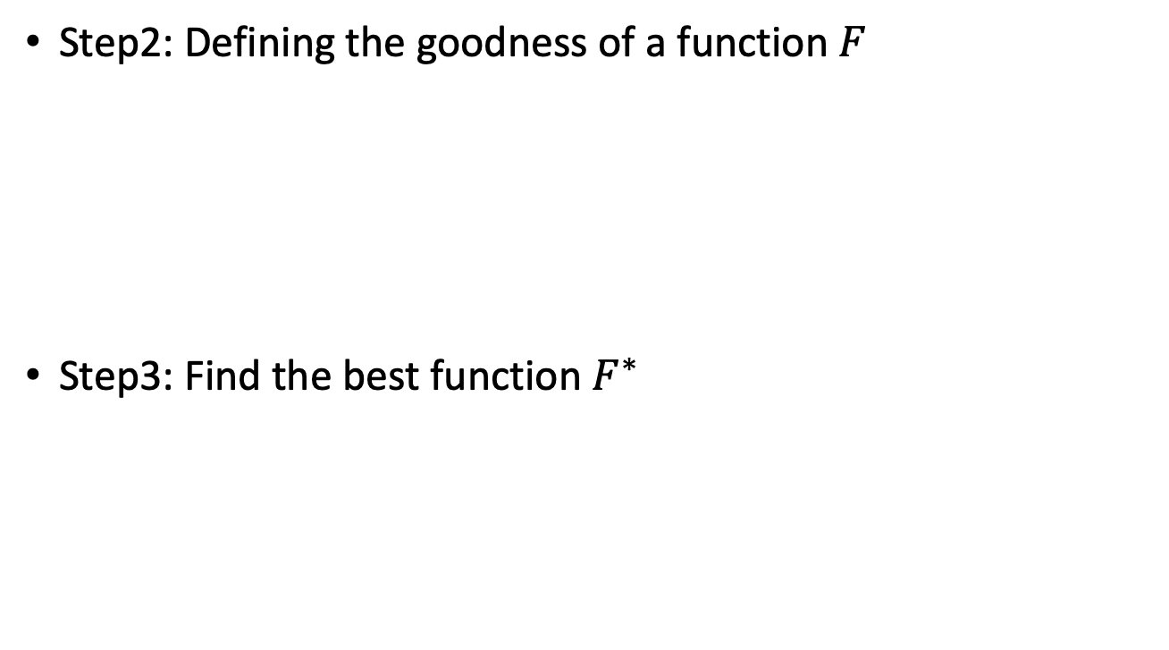
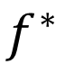
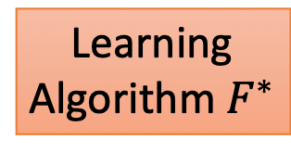
Meta Learning
Step2: Defining the goodness of a function $F$
Step3: Find the best function $F^{∗}$
$$L\left(F\right)=\sum_{n=1}^{N}{l^{n} }$$
Train
Testing: Task New
bike
car
Learning
Algorithm $F^{∗}$
Test
$$F^{∗}=arg\min_{F}{L\left(F\right)}$$
$$f^{∗}$$
bike
car
$$l$$

Slide 18
Meta Learning
Memory based
LSTM
Gradient based
MAML
Reptile
Metric based
Siamese Network
Prototypical Network
Matching Network
Relational Network

Slide 19
Meta Learning
MAML
Chelsea Finn, Pieter Abbeel, and Sergey Levine, “Model-Agnostic Meta-Learning for Fast Adaptation of Deep Networks”, ICML, 2017
Reptile
Alex Nichol, Joshua Achiam, John Schulman, On First-Order Meta-Learning Algorithms, arXiv, 2018
Notes:
Pieter Abbeel： 吴恩达的学生 1门课CS188 AI入门课，人工智能实验室联合主任
AIMA那本书中RL大篇幅讲解，UR的AI中只有小部分
Chelsea Finn：MIT 4年 BS；Berkeley 4年phd，18年毕业；15年 CS188的TA

Slide 20
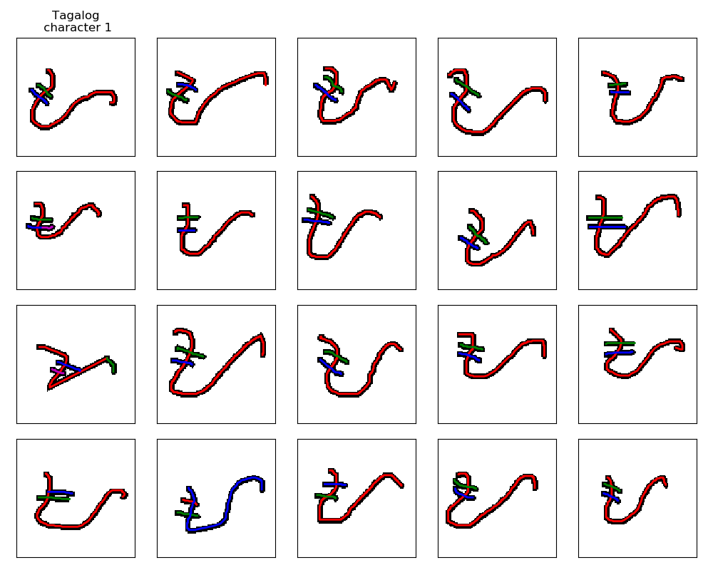
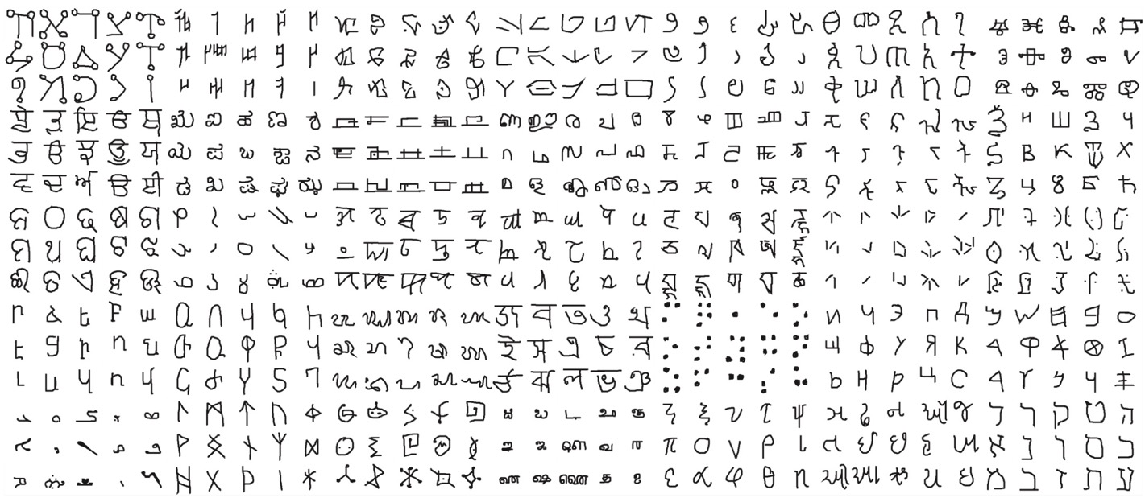
Omniglot
https://github.com/brendenlake/omniglot
1623 characters
Each has 20 examples

Slide 21
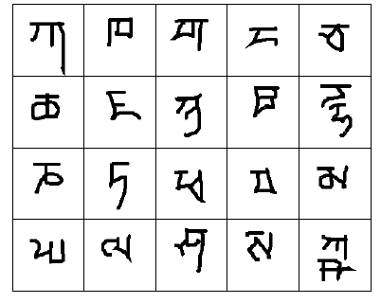
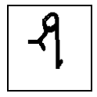
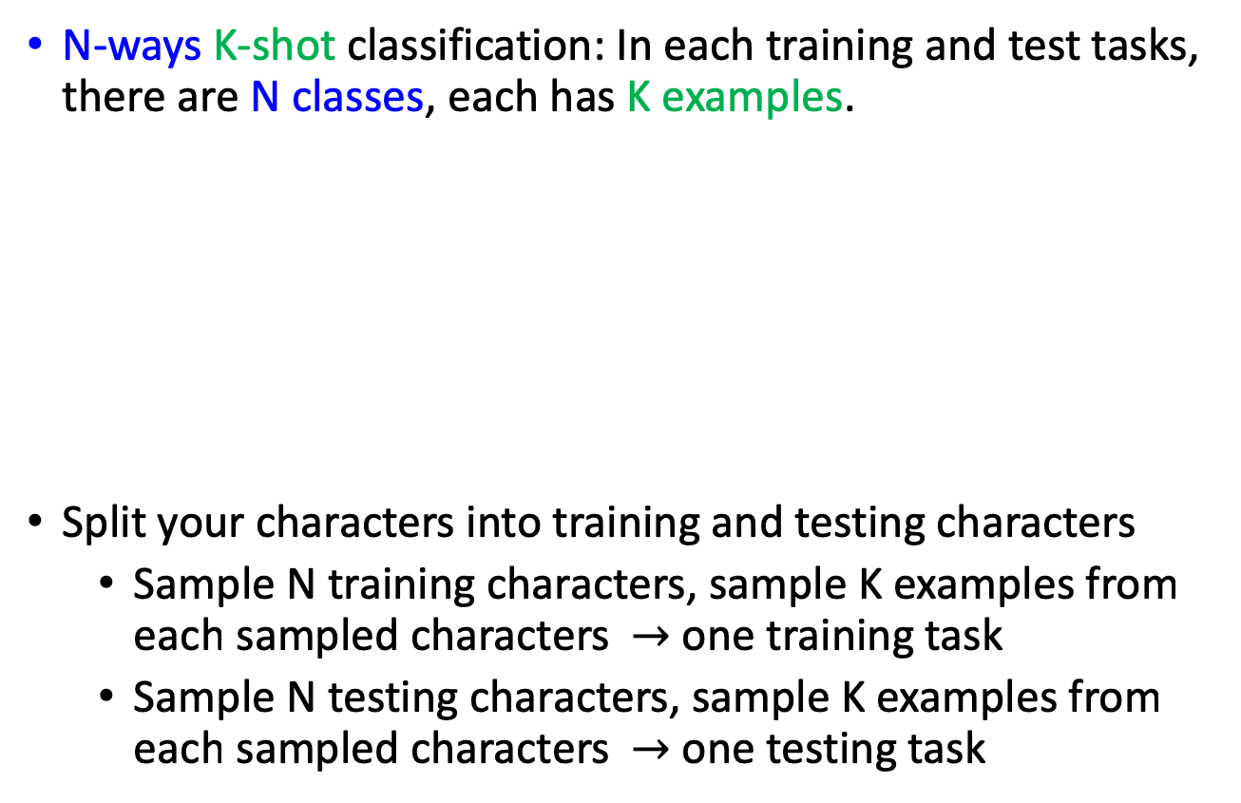
Demo of Reptile:
https://openai.com/blog/reptile/
Omniglot – Few-shot Classification
N-ways K-shot classification: In each training and test tasks, there are N classes, each has K examples.
Split your characters into training and testing characters
Sample N training characters, sample K examples from each sampled characters $→$ one training task
Sample N testing characters, sample K examples from each sampled characters $→$ one testing task
20 ways
1 shot
Testing set
(Query set)
Each character represents a class
Training set
(Support set)

Slide 22
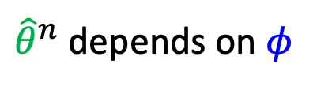
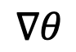
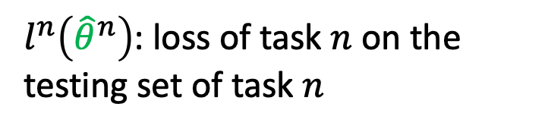

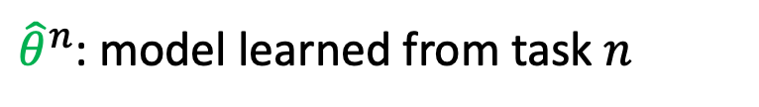
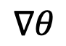

MAML
${\hat{θ}}^{n}$: model learned from task $n$
Loss Function:
${\hat{θ}}^{n}$ depends on $φ$
$$L\left(φ\right)=\sum_{n=1}^{N}{l^{n}\left({\hat{θ}}^{n}\right) }$$
$l^{n}\left({\hat{θ}}^{n}\right)$: loss of task $n$ on the testing set of task $n$
$$\hat{θ}$$
Network
Structure
$$φ$$
Update
Update
$$θ^{0}$$
$$θ^{1}$$
$$θ^{2}$$
Init
$$∇θ$$
$$∇θ$$
Learning Algorithm
(Function $F$)
Compute Gradient
Compute Gradient
Training
Data
Training
Data

Slide 23


MAML
两个loop
Inner loop。Base model。也叫adaptation loop。
Outer loop. Meta model.

Slide 24



MAML
$$φ←φ−η∇_{φ}L\left(φ\right)$$
$$L\left(φ\right)=\sum_{n=1}^{N}{l^{n}\left({\hat{θ}}^{n}\right) }$$
$$\hat{θ}＝φ－ε∇_{φ}l\left(φ\right)$$

Slide 25

MAML
${\hat{θ}}^{n}$: model learned from task $n$
Loss Function:
${\hat{θ}}^{n}$ depends on $φ$
$$L\left(φ\right)=\sum_{n=1}^{N}{l^{n}\left({\hat{θ}}^{n}\right) }$$
$l^{n}\left({\hat{θ}}^{n}\right)$: loss of task $n$ on the testing set of task $n$
How to minimize $L\left(φ\right)$?
Gradient Descent
$$φ←φ−η∇_{φ}L\left(φ\right)$$
Model Pre-training
Loss Function:
$$L\left(φ\right)=\sum_{n=1}^{N}{l^{n}\left(φ\right) }$$
Widely used in transfer learning
Notes:
MAML：找init去让在各个base learner上loss最小
而pre train 当前最小

Slide 26
MAML
寻找一组具有高度适应性的参数θ的过程。

Slide 28










MAML
No: $φ$ 在 training task 表现
$$L\left(φ\right)=\sum_{n=1}^{N}{l^{n}\left({\hat{θ}}^{n}\right) }$$
Yes: $φ$ 训练出來的 ${\hat{θ}}^{n}表现$
$l^{1}$ (Loss of task 1)
$l^{2}$ (Loss of task 2)
Small $l^{2}\left({\hat{θ}}^{2}\right)$
$${\hat{θ}}^{1}$$
$$φ$$
$${\hat{θ}}^{2}$$
Model Parameter
Small $l^{1}\left({\hat{θ}}^{1}\right)$

Slide 29





Model Pre-training
所有 task 都最好的 $φ$
$$L\left(φ\right)=\sum_{n=1}^{N}{l^{n}\left(φ\right) }$$
并不保证$φ$ 训练会得到good ${\hat{θ}}^{n}$
$l^{1}$ (Loss of task 1)
$l^{2}$ (Loss of task 2)
$$l^{2}\left({\hat{θ}}^{2}\right)$$
$$φ$$
Model Parameter

Slide 30









Why one step？
Fast
Good to truly train a model with one step.
Few-shot learning has limited data.(Over-fitting)
MAML
$$\hat{θ}$$
$$L\left(φ\right)=\sum_{n=1}^{N}{l^{n}\left({\hat{θ}}^{n}\right) }$$
Network
Structure
$$φ$$
Update
$$θ^{0}$$
Init
$$g$$
Learning Algorithm
(Function $F$)
$$φ←φ−η∇_{φ}L\left(φ\right)$$
Compute Gradient
Considering one-step training:
Only focus on initialization parameter
Training
Data
$$\hat{θ}＝φ－ε∇_{φ}l\left(φ\right)$$
$$φ$$
Notes:
每来一个task用train set算gradient 只求一次倒数然后用 lr 更新一次

Slide 31










MAML – Real Implementation
Sample a training task m
$${\hat{θ}}^{m}$$
Model Pre-training
$$φ^{0}$$
$$φ^{1}$$
$${\hat{θ}}^{m}$$
$$φ^{1}$$
$${\hat{θ}}^{n}$$
$$φ^{2}$$
$${\hat{θ}}^{n}$$
Sample a training task n
$$φ^{0}$$
$$φ^{2}$$

Slide 32


Performance
Model Pre-training
MAML
Notes:
Model pre-train: 近乎水平线，找出一个初始函数在所有的sin函数上都效果最好，将所有的sin叠起来就是一个水平线
MAML：绿色未做任何训练的线

Slide 33


Omniglot & Mini-ImageNet
N-way classification:
Use N class during test with K-shot learning
Network Architecture
4 modules:
3 * 3 conv and 64 filters
ReLU
2 * 2 max-pooling
No Conv
256, 128, 64, 64 with Relu
Notes:
5way 对比 20way
1shot 对比 5shot
No conv： 非CNN的网络

Slide 34

18 training tasks: 18 different languages translating to English
Translation
2 validation tasks: 2 different languages translating to English
Ro = Romanian
Fi = Finnish
https://arxiv.org/abs/1808.08437

Slide 36
Meta Learning
MAML
Chelsea Finn, Pieter Abbeel, and Sergey Levine, “Model-Agnostic Meta-Learning for Fast Adaptation of Deep Networks”, ICML, 2017
Reptile
Alex Nichol, Joshua Achiam, John Schulman, On First-Order Meta-Learning Algorithms, arXiv, 2018
Notes:
Reptile 很简单，比MAML更简单

Slide 37

Reptile

Slide 38





Sample a training task m
Reptile
$$φ^{0}$$
$$φ^{1}$$
$${\hat{θ}}^{m}$$
$$φ^{2}$$
Sample a training task n
$${\hat{θ}}^{n}$$
(Appeared in the eariest version)
Notes:
和我们前面提到的pre train很像，找一个与所有tasks距离最小的参数，论文中提到如果只update一次 和 到所有距离的期望损失是一致的，这个和pre train相同。
3月8日提交的第一版本，check是否是愚人节，非常的应景

Slide 39







Pre-train: $g_{1}$
$$g_{1}$$
$$g_{2}$$
Reptile
$$φ$$
Reptile: $g_{1}+g_{2}$
MAML: $g_{2}$
(simplified)
Pre-train
Notes:
Reptile 并没有限制只能走两步
明显看到pretrain 特别菜

Slide 40
Training a network (by RL) to determine …
Architecture
& Activation
How to update
$$\hat{θ}$$
Network
Structure
$$φ$$
Update
Update
$$θ^{0}$$
$$θ^{1}$$
$$θ^{2}$$
Init
$$∇θ$$
$$∇θ$$
Learning Algorithm
(Function $F$)
Compute Gradient
Compute Gradient
MAML, Reptile
Training
Data
Training
Data
Notes:
虽然看起来在做人工智能，但其实我们每天做的事情都是调参数
穷举所有 width 和 depth
Sample random search （从所有20个里面随机选出10个点）

Slide 42
Meta Learning
Memory based
LSTM
Gradient based
MAML
Reptile
Metric based
https://openreview.net/pdf?id=rJY0-Kcll
Siamese Network
Prototypical Network
Matching Network
Relational Network
https://arxiv.org/abs/1606.04474

Slide 43
RNN Review

Slide 44








Memory Based
$$\hat{θ}$$
Network
Structure
$$φ$$
Update
Update
$$θ^{0}$$
$$θ^{1}$$
$$θ^{2}$$
Init
$$∇l$$
$$∇l$$
Learning Algorithm
(Function $F$)
Compute Gradient
Compute Gradient
The learning algorithm looks like RNN.
Training
Data
Training
Data
Notes:
把过去的时许存在memory中
比如这边的sita
将当作LSTM来看

Slide 45

RNN Review
Given function f: $h^{′},y=f\left(h,x\right)$
y¹
y²
y³
h⁰
f
h¹
f
h²
f
h³
……
x¹
x²
x³
No matter how long the input/output sequence is, we only need one function f

Slide 46
y^{t}
LSTM Review
LSTM
c^{t}
y^{t}
c^{t-1}
Naïve
RNN
h^{t}
h^{t}
h^{t-1}
h^{t-1}
x^{t}
x^{t}
c change slowly
c^{t} is c^{t-1} added by something
h change faster
h^{t} and h^{t-1} can be very different
Notes:
C和h 扮演了不同的角色
将c 用 sita来替代
将st和ht换成gradient

Slide 47














Typical LSTM
LSTM for Gradient Descent
$$c^{t}=z^{f}⨀c^{t−1}$$
$$+z^{i}⨀z$$
$$−∇_{θ}l$$
$$θ^{t}$$
$$θ^{t−1}$$
Learn to minimize
3 training steps
Testing Data
$$l\left(θ^{3}\right)$$
Learnable
“LSTM”
“LSTM”
“LSTM”
$$θ^{0}$$
$$θ^{1}$$
$$θ^{2}$$
$$θ^{3}$$
$$−∇_{θ}l$$
$$−∇_{θ}l$$
$$−∇_{θ}l$$
Independence assumption
Batch from train
Batch from train
Batch from train
Notes:
将y 和 y hate算一个cross entropy
初始化参数 用batch算出gradient，丢到一个LSTM里面进行运算，
以前参数 是 人设置的，现在 在meta learning的架构下学出来
用testing data去调整整个LSTM的参数
最后初始参数sita0 也能一起学出来，类似MAML
Forget gate 和 input get

Slide 48


https://arxiv.org/abs/1606.04474
Experimental Results
Notes:
train 20 个和 test 40个 的
Train 1层， test 时候2 层隐藏层
Train sigmoid， test relu 做不起来 （激活函数本身差别巨大，relu是类似线性的）

Slide 50
Meta Learning
Memory based
LSTM
Gradient based
MAML
Reptile
Metric based
Siamese Network
Prototypical Network
Matching Network
Relational Network

Slide 51

Metric Based – Image search
In each task:
Few-shot Learning
Registration (Collecting Training data)
Testing
Return the similar products
Training

Slide 52










Meta Learning
Yes
Network
Train
Test
Yes
No
Training
Tasks
Test
No
Train
Network
Train
Test
No
?
Network
Testing
Tasks
Yes
or
No
Train
Test

Slide 53



https://www.cs.cmu.edu/~rsalakhu/papers/oneshot1.pdf
No
Metric：Siamese Network
Network
CNN
embedding
Train
Same
share
Similarity
score
CNN
Yes
Large score
embedding
Small score
No
Test
Notes:
为什么是meta learning的一部分

Slide 54


Metric：Siamese Network
Learning embedding for products
Far away
CNN
e.g. learn to ignore the background
As close as possible
CNN
CNN
Notes:
用CNN将所有的手机都映射到同一个空间上

Slide 55






N-way Few/One-shot Learning
Example: 5-ways 1-shot
iPhoneX
Network (Learning + Prediction)
iPhone4
iPhone5
iPhone6
iPhoneX
Huawei
Testing
Data
Training Data (Each image represents a class)
Notes:
如果是一个identification ，能够分出是哪一个

Slide 56







Prototypical Network
Testing
Data
$$s_{1}$$
$$s_{2}$$
$$s_{3}$$
$$s_{4}$$
$$s_{5}$$
CNN
CNN
CNN
CNN
CNN
CNN
= similarity
https://arxiv.org/abs/1703.05175
Notes:
将5张图片的embeding平均起来

Slide 57
Matching Network
Considering the relationship among the training examples
$$s_{1}$$
$$s_{2}$$
$$s_{3}$$
$$s_{4}$$
$$s_{5}$$
CNN
Bidirectional LSTM
= similarity
https://arxiv.org/abs/1606.04080
Notes:
加了一个双向LSTM，互相之间也是有关系的
先有matching 再有 prototyical
用双向不是很有道理
对调两个图片的顺序会训练成一个不同的网络

Slide 58

Relation Network
???
https://arxiv.org/abs/1711.06025
Notes:
相似度用另一个network算出来
抽取embedding 和 相似度计算是一起被学出来的

Slide 60
3

Slide 61

Meta-learning with differentiable closed-form solvers （ICLR19）
核心：如何提取training set中的X和Y的信息，并直接迁移到test-set中使用。
Notes:
原来有一个SNAIL的网络，较大，且用了attention的机制
不能暴力，用数学一点的优雅方式，构造了一个ridge regression的闭式解，A与e点乘即可
最大的优势：数学降维

Slide 62

Dynamic Few-Shot Visual Learning without Forgetting（CVPR18）
1）feature extractor
2）few-shot classification weight generator
Notes:
training set训练出一个feature extractor
核心：利用新的noval data和 base weight 作为输入，计算其对应的weight

Slide 63

TADAM: Task dependent adaptive metric for improved few-shot learning（NIPS18）
1）Metric Scaling
2）Task conditioning
3）Auxiliary task co-training
Notes:
scaling factor ，这样能够更好的使得输出的metric在合适的范围内
Task conditioning， 构造一个TEN网络，输入样本的到task representation之后，经由这个网络输出的每一个task的feature变得不一样
Auxiliary task co-training，也先用所有数据训练一个extractor，作为辅助人任务
细节取得显著效果，14%于5w5s mini imageNet分类上，特别是第二个Task conditioning，这说明我们应该训练更加meta 、task自适应能力更强的网络

Slide 64

Meta-Learning with Latent Embedding Optimization（ICLR19）
latent embedding space，先对输入的图像x进行encode得到latent code z，然后再decode出最后分类用的参数w，并直接用w和z使用MAML的方式进行训练。
Notes:
核心 是学习了一个stochastic model parameter generator，解决MAML不能处理高维数据

Slide 65

Low-Shot Learning from Imaginary Data
https://arxiv.org/abs/1801.05401
Notes:
一张图片想象出多张图片，训练出一个generator

Slide 66
小结
1）预训练一个feature extractor
2）让模型更加的meta，更加自适应
3）进一步优化feature extractor的效果
4）进一步利用各种方式减少过拟合
Notes:
18年1年50%-》60%
还有提升空间，要更充分的利用meta data

Slide 67
4

Slide 68

What for us？
1）各场景 之间差异
2）新样本很noval
3）新样本数据量较小
4）现有场景数据量较充裕
5）平台之外
1）各个场景数据作为task
2）平台/平台之外训练feature extractor
3）Imaginary丰富样本
4）TEN网络做task自适应

Slide 70
Reference
论文：
Model-Agnostic Meta-Learning for Fast Adaptation of Deep Networks 17 ICML
Reptile:On First-Order Meta-Learning Algorithms 18
ICLR19：https://openreview.net/pdf?id=HkNDsiC9KQ
https://arxiv.org/pdf/1810.02334.pdf
[Memory based]
https://arxiv.org/abs/1606.04474
https://openreview.net/pdf?id=rJY0-Kcll
[Metric based]
https://www.cs.cmu.edu/~rsalakhu/papers/oneshot1.pdf
https://arxiv.org/abs/1703.05175
https://arxiv.org/abs/1606.04080
https://arxiv.org/abs/1711.06025

Slide 71
Reference
论文：
Meta-learning with differentiable closed-form solvers （ICLR19）
TAFE-Net: Task-Aware Feature Embeddings for Low Shot Learning （CVPR19）
Meta-Transfer Learning for Few-Shot Learning （CVPR19）
TADAM: Task dependent adaptive metric for improved few-shot learning（NIPS18）
Meta-Learning with Latent Embedding Optimization（ICLR19）
Dynamic Few-Shot Visual Learning without Forgetting（CVPR18）
博客：
http://codewithzhangyi.com/2018/07/26/AutoML/
https://openai.com/blog/reptile/
[Flood Sung]
https://zhuanlan.zhihu.com/p/46339823
https://zhuanlan.zhihu.com/p/40600485
https://zhuanlan.zhihu.com/p/28639662
https://zhuanlan.zhihu.com/p/46059552

Slide 72
Reference
博客：
[Others]
https://cloud.tencent.com/developer/article/1421248
https://baijiahao.baidu.com/s?id=1629626559555746572&wfr=spider&for=pc
https://zhuanlan.zhihu.com/p/37675368
视频：
https://www.youtube.com/watch?v=wT45v8sIMDM&t=28s
教程[李宏毅]：
http://speech.ee.ntu.edu.tw/~tlkagk/courses_ML19.html
Notes:
也感谢
蓝姐：一起看论文
陈博士：请教展示的细节
清宇：服务器相关

Slide 73
THANK YOU

